Slide 1

IoT Simulators NS3 and SUMO
Presented By – Shreya Mishra
Indian Institute Of Science

Slide 2
Why do we need Simulators ?
Network connection plays a vital role as IoT is all about the data being communicated in faster speeds all the time. IoT architecture has to be tested in all kinds of network connectivity/speeds. To test this, virtual network simulators are mostly used to vary the network load, connectivity, stability etc.
Availability
Portability
Cost effective
No Time Constraints
Ease of setup
Examples – Cooja , NS3, SUMO, Gazebo

Slide 3
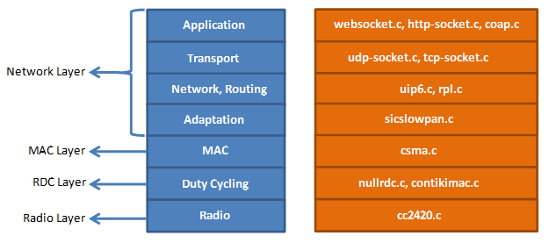
When to choose what? (Cooja/NS3/MiniNet)
Contiki plays the best role when working with power constrained networks.
Eg- 802.15.4
Best to be used with Zolertia motes, TelosB
RPL knowledge is necessary
Knowledge Of C is must
NS3 is suitable to test almost all real time network usage eg- Wi-Fi, LTE, FANET etc
Can be used for Drone/V2x simulation
Network /Link Performance Analysis is easy
Knowledge Of C++ and Python is must
MiniNet acts as an emulator for SDN networks
Supports
The Mininet-WiFi developers extended the functionality of Mininet by adding virtualized WiFi stations and access points based on the standard Linux wireless drivers and the 80211_hwsim wireless simulation driver.

Slide 4
Network Simulator (NS3)
Ns3 is a discrete event network simulator. It provides a simulation time and it jump from one event to another event. Ns3 contains various inbuilt libraries and modules within a directory. It supports Graphical user interface and python bindings.
Model Development
Develop by a Defined Channel and Mobility Models
Simulate a Model according to Events
Node and also Link Configuration
Define Node and Link Attributes (Data rate, Latency and also Packet Loss)
Manage Command Arguments
Simulation Execution
Building a File and also Analyze Outputs in a Command Prompt
Performance Analysis
Modeling Network by using NetAnim
Analyze the Performance under GNU plot
ns-3 | a discrete-event network simulator for internet systems (nsnam.org)

Slide 5
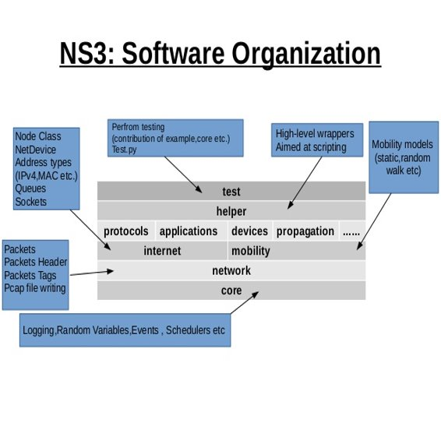
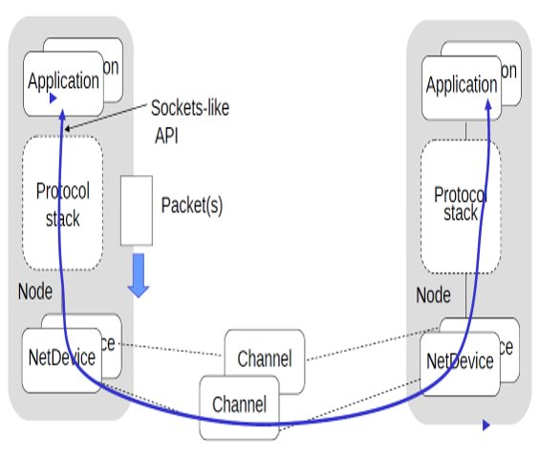
How Does NS3 Work?

Slide 6
SUMO (Simulation Of Urban Mobility)
• SUMO is an open source traffic simulation package including net import and demand modeling components.
• The German Aerospace Center (DLR) started the development of SUMO back in 2001.
• It involves route choice and traffic light algorithm or simulating vehicular communication.
Features
Automated Driving, Vehicle Communication, Traffic Management, Microscopic Simulation, Multimodal Traffic, Online Interaction, Network Import
Definition of Vehicles, Vehicle Types, and Routes - SUMO Documentation (dlr.de)

Slide 7
Working (Sumo)
In order to create simulation in SUMO first create a road network on which vehicles can move.
The road network consists of nodes (junctions) and edges (i.e. roads that connect various junctions with each other).
Road network can be created in three ways:
1. Manually by creating your own node file, edge file and connection file.
2. Using NETGENERATE command.
3. Importing road network from non SUMO formats like OSM, VISSIM, VISUM etc

Slide 8
Multi-drone systems
Multiple drones cooperate and communicate with each other.
Single drone is far less capable as an entity.
Applications
military missions (battlefield surveillance)
searching for survivors in disaster hit areas
delivery of payload
drone light shows
smart city, etc.
Complexity lies in the co-ordinated movement.

Slide 9
Why do we need simulators for UAV?
Resource requirement for experiments
UAVs
network devices
flight controllers
Precise evaluation of UAV’s mobility
Simulation environments: ROS, AirSim, Gazebo, PyBullet
Challenging integration for fleet deployment
Validate an UAV fleet deployment in a city
observing traffic at hot-spots during commute hours
status of building construction
Package delivery

Slide 10
Robot Operating System (ROS) Framework
Robots and autonomous vehicles development
Architecture and communications
topics, services and actions
ideal to control a distributed network of sensor and actuator
common work frame
well-defined data structures
Scalable and suitable for a range of different platforms that can be easily integrated into a single environment.
Flexible framework for writing robot software.
Collection of tools, libraries, and conventions
From the robot’s perspective, problems that seem trivial to humans often vary wildly
Linux-like command tool, inter-process communication system

Slide 11
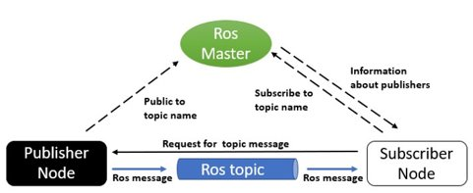
ROS Communication
https://trojrobert.github.io/hands-on-introdution-to-robot-operating-system(ros)/

Slide 12
Physics Simulator: Gazebo
Open-source multi-robot simulator
dynamic environments near to real scenarios
Flight controller integration
Software-In-The Loop (SITL) drone simulation (e.g. – Pixhawk, PX4)
Client/Server architecture with topic-based Pub/Sub model of inter-process communication
Gazebo clients access data through a shared memory
Inter-process communication
Simulation objects associated with controllers
process commands for controlling the object
generate the state of that object.
Client sends control data, simulated objects’ coordinates to the Server which performs the real-time control of the simulated drone

Slide 13
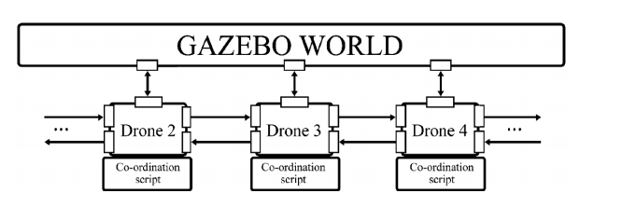
Gazebo World
https://link.springer.com/chapter/10.1007/978-3-030-14984-0_24

Slide 14
DEMO

